Slide 1
COS 212 Indirect, Nested & Excessive Recursion and Backtracking

Slide 2
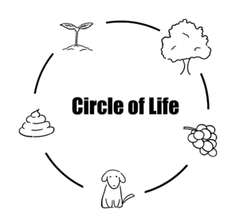
Types of Recursion: Indirect Recursion
A recursive function f() does not call itself
Instead, f() invokes g(), and g() returns the control back to f() by invoking it
f() -> g() -> … -> f()
Following links on the internet can take you to the original page
wash(clothes) {
iron(clothes)
}
iron(clothes) {
hangUp(clothes)
}
hangUp(clothes) {
wear(clothes)
}
wear(clothes) {
wash(clothes) // Indirect recursion!
}

Slide 3
Types of Recursion: Indirect Recursion
Mutual recursion: two functions calling each other
boolean isEven(int n) {
if (n == 0)
return true;
else if (n > 0)
return isOdd(n - 1);
else
return isOdd(n + 1);
}
boolean isOdd(int n) {
if (n == 0)
return false;
else if (n > 0)
return isEven(n - 1);
else
return isEven(n + 1);
}
Base cases are equally important for all types of recursion
Is 5 even?
isEven(5)
isOdd(4)
isEven(3)
isOdd(2)
isEven(1)
isOdd(0)
FALSE
Is 5 odd?
isOdd(5)
isEven(4)
isOdd(3)
isEven(2)
isOdd(1)
isEven(0)
TRUE

Slide 4
Types of Recursion: Nested Recursion
In case of nested recursion, recursive function call with a parameter that is also a recursive function call:
int nested(int i) {
if (i == 0) return 0;
else if (i > 4) return i;
else return nested(2 + 2 * nested(2*i));
}
What will nested(1), nested(2), nested(3) and nested(4) return?

Slide 5
Types of Recursion: Nested Recursion
nested(1) nested(2 + 2 * nested(2*1))
78
38
nested(2 + 2 * nested(2*2))
18
nested(2 + 2 * nested(2*4))
8
nested(3) nested(2 + 2 * nested(2*3))
14
6
int nested(int i) {
if (i == 0)
return 0;
else if (i > 4)
return i;
else return
nested(2 + 2 * nested(2*i));
}

Slide 6
Types of Recursion: Nested Recursion
How bad is nested recursion in terms of time/space efficiency?
Ackermann-Péter function:
int acker(int i, int j) {
if (i == 0)
return j + 1;
else if (i > 0 && j == 0)
return acker(i – 1, 1);
else
return acker(i – 1, acker(i, j – 1));
}
What is the depth of recursion for acker(3,2)?
31
What about acker(4,2)?
acker(1,2)
acker (0,3)
acker (0,2)
acker(1,0)
acker(0,1)
acker(1,1)
4
Exceeds atoms in the universe!

Slide 7
Excessive Recursion
There is a price associated with using recursion
Slower execution time
Wasted storage on the run-time stack
If the recursion continues to a deep enough level
We can run out of stack space
The program will then terminate abnormally
The program also raises an unrecoverable StackOverflowError
Example:
The Fibonacci sequence: 0, 1, 1, 2, 3, 5, 8, 13, …
Find n^{th} Fibonacci number
We can do this recursively or iteratively
The recursive implementation is much simpler and more intuitive
But if we run each implementation, iteration is very clearly faster
Recursion runs out of stack space for very large values of n

Slide 8
Excessive Recursion
Finding n^{th} Fibonacci number: Recursive solution
long fibonacci(long n) {
if (n < 2) {
return n;
} else {
return fibonacci(n - 2) + fibonacci(n - 1);
}
}

Slide 9
Excessive Recursion
Finding n^{th} Fibonacci number: Iterative solution
long fibonacci(long n) {
if (n < 2) {
return n;
} else {
long temp;
long current = 1;
long last = 0;
for (long i = 2; i <= n; i++) {
temp = current;
current += last;
last = temp;
}
return current;
}
}

Slide 10
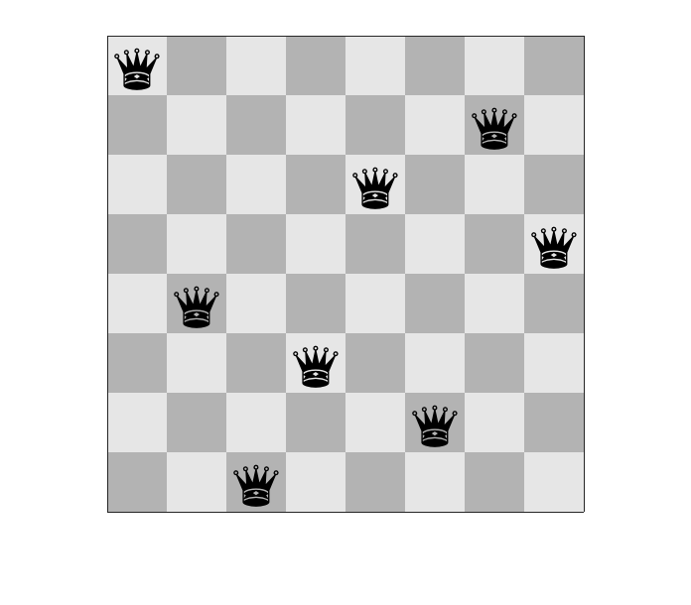
Backtracking
Sometimes we need to search for a complex solution
A solution that consists of multiple interacting parts
Consider the eight queens problem
We have a standard chess board with 8 rows and 8 columns
A queen threatens all squares along the row, column and both diagonals from its position on the board
One queen must be placed in every column
No queen may be threatened by any other queen

Slide 11
Backtracking
A valid solution to the eight queens problem

Slide 12
Backtracking
We can visualise a search for a solution as a tree of nodes
The topmost node (the root) represents the unsolved problem
In this case the topmost node is an empty chess board
Branches connect the root node to 2nd level nodes representing every possible first step in solving the problem
In this case the root node connects to eight 2nd level nodes,
each of which represents a possible position for the first queen
Each 2nd level node is connected to 3rd level nodes representing every possible second step in solving the problem
In this case each 2nd level node is connected to 3rd level
nodes, each representing the first queen position for the 2nd
level node and a possible position for the second queen
And so on…

Slide 13
Backtracking
Q
Q
Q
Q
Q
Q
Q
Q
.
.
Partial tree representing queen positions
.
.

Slide 14
Backtracking
There are some complexities in the search
It isn’t obvious which paths lead to a complete solution
Many paths lead to dead ends (nodes with no possible valid next step, which represent an invalid partial solution)
We also don’t want to create the whole tree
This would be time-consuming and wasteful to store
So, we use a backtracking search
We generate one 2nd level node, then one 3rd level node
And so on, until we find either a solution or a dead end
If we find a solution, we stop searching and return the solution
If we find a dead end, we backtrack to the previous level, discard the dead end node, and try a different valid next step
We might even backtrack to the top of the tree several times
But we’ll find a solution, even if the whole tree must be explored

Slide 15
Backtracking
Q
X
Q
X
Q
X
Q
X
Q
X
X
Q
X
Q
X
Q
Q
Q
Q
Q
Q
Q
Example of backtracking

Slide 16
Backtracking
We can use a recursive strategy to implement the search
placeQueen(column) {
for every valid position p in column
place a piece in position p
if column is not the last column
placeQueen(column + 1)
else
terminate with complete solution
}

Slide 17
Backtracking
On the next slide is an animation of the search for a solution to the smaller six queens problem
The solution places queens row by row, not column by column
Red crosses in empty cells indicate that no queen can be placed there, and backtracking must take place
A red cross on a queen indicates that backtracking has to try a new position for that queen
If a new valid position is unavailable for a queen, backtracking occurs to the previous queen, which must be placed in a new position

Slide 18
Backtracking
An animation of a search for a solution to the six queens problem

